Slide 1
DARK WEB CRAWLER AND SCRAPER WITH LLM-BASED SECURITY ANALYSIS
TEAM MEMBERS: 1. ROJA S (620822205089)
2. SWETHA S (620822205112)
3. SARANYA M (620822205095)
4. SHARMILA K (620822205099)
GUIDE : Mrs.S.SARANYA,AP/IT
GNANAMANI COLLEGE OF TECHNOLOGY.

Slide 2
Problem Statement
Exploring the dark web manually is time-consuming and risky.
Hidden links and anonymous sites make navigation difficult.
Traditional web crawlers cannot access Tor-based dark web sites.
Extracting relevant information manually is inefficient and prone to errors.
Security and privacy concerns make dark web data collection challenging
There is a lack of systematic analysis of existing crawler and scraper architectures

Slide 3
Objective
To design a dark web crawler capable of navigating Tor network safely.
To implement a scraper module that efficiently extracts relevant data.
To analyze and filter the collected data for meaningful insights.
To evaluate existing crawler and scraper architectures for performance
To address challenges like anonymity, security, and ethical issues
To provide a systematic overview for future dark web research

Slide 4
Existing System
Current web crawlers are mainly designed to explore the surface web and cannot access dark web content that runs on the Tor network. Manual exploration of the dark web is risky, time-consuming, and unsafe. Most existing scrapers are not built to handle anonymous or hidden websites, making data extraction difficult. Collecting information from the dark web also requires stronger security measures, which many systems lack.
Disadvantage
Manual dark web exploration is slow, risky, and inefficient. ️
Normal crawlers cannot access Tor-based hidden websites.
Existing scrapers struggle with encrypted or dynamic content.
Ethical, legal, and large data handling issues reduce effectiveness.

Slide 5
Proposed System :
The proposed system develops a secure dark web crawler that can safely navigate the Tor network. It includes an automated scraper module to efficiently extract relevant information from dark web pages. A data analysis layer is added to filter, organize, and process the collected data, while encrypted storage ensures that all information is stored securely. The system also incorporates ethical and legal controls to promote responsible crawling.
Advantage :
Automated crawling saves time and improves speed and accuracy.
Can safely access Tor-based dark web content.
Secure storage and organized data improve reliability.

Slide 6
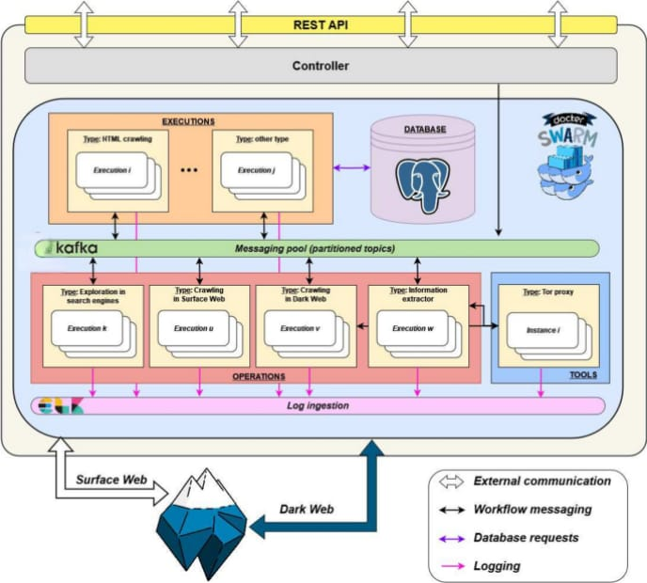
SYSTEM ARCHITECTURE/FLOW DIAGRAM

Slide 7
Modules :
Module 1 – Crawler Module
Navigates dark web links safely using the Tor network.
Module 2 – Scraper Module
Extracts relevant and structured data from crawled pages.
Module 3 – Data Analysis Module
Filters, processes, and analyzes collected information using AI techniques.
Module 4 – Storage & Security Module
Stores data securely in encrypted databases with controlled access.
Module 5 – Reporting & Monitoring Module
Generates intelligence reports and monitors system performance.

Slide 8
Module 1 – Crawler Module
Purpose: Discover and securely access dark web (.onion) websites automatically.
Key Responsibilities:
Establish secure connection using Tor network.
Start crawling from predefined seed URLs.
Discover new linked pages automatically.
Avoid duplicate and invalid links.
Core Flows:
Initialize Tor connection and load seed URLs.
Crawl links within defined depth limits.
Store visited URLs to prevent repetition.
Handle broken or inaccessible pages efficiently
.
Security & Compliance:
Maintain anonymity during crawling.
Follow ethical crawling guidelines.
Log crawling activity for monitoring and auditing.

Slide 9
Module 2 – Scraper Module
Purpose: Extract relevant and meaningful data from crawled web pages.
Key Responsibilities:
Parse HTML content from collected pages.
Remove scripts, ads, and unwanted elements.
Extract useful text, titles, and discussion content.
Convert raw data into structured format.
Core Flows:
Receive raw page data from crawler.
Clean and preprocess extracted content.
Filter only relevant cybersecurity-related information.
Store structured output for analysis.
Security & Compliance:
Avoid collecting unnecessary sensitive data.
Maintain logs of extracted information.
Ensure responsible and ethical data usage.

Slide 10
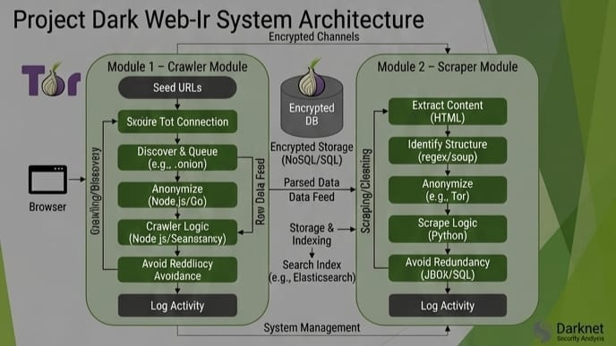

Slide 11
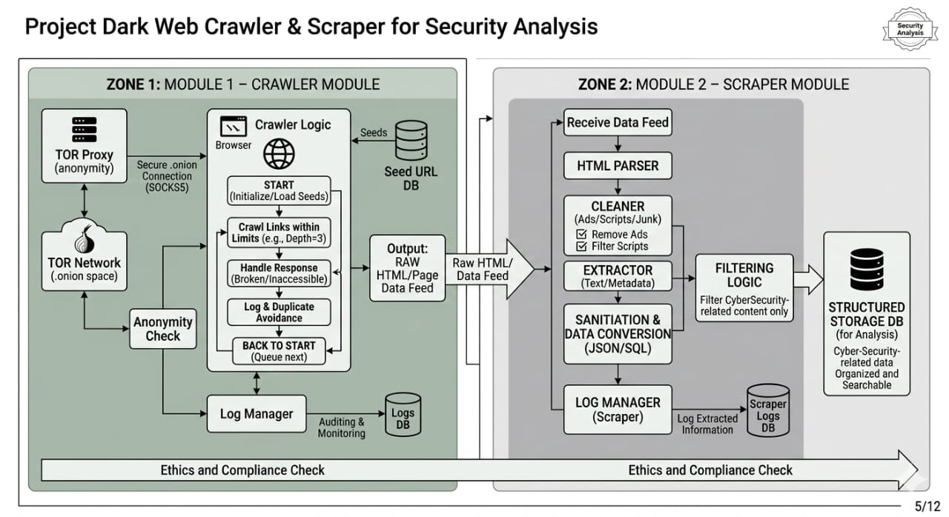

Slide 12
Module 3 – Data Analysis Module
Purpose: Analyze extracted data to detect threats, risks, and patterns.
Key Responsibilities:
Perform text cleaning and preprocessing.
Identify suspicious keywords and activities.
Apply NLP and AI-based analysis techniques.
Classify content into meaningful categories.
Core Flows:
Process structured data from scraper.
Run keyword and pattern detection algorithms.
Perform sentiment and topic analysis.
Generate actionable threat intelligence insights.
Security & Compliance:
Maintain transparency in analysis process.
Reduce bias in AI-based predictions.
Follow cybersecurity research standards.

Slide 13
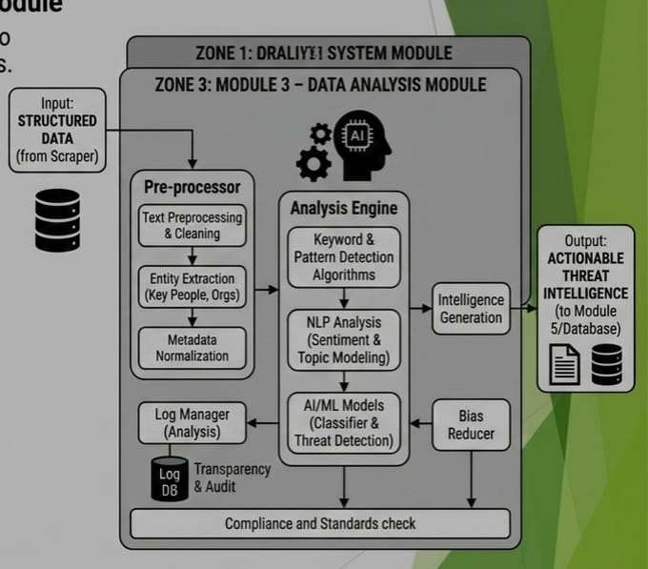

Slide 14
Module 4 – Storage & Security Module
Purpose: Securely store and protect collected and analyzed information.
Key Responsibilities:
Encrypt sensitive data before storage.
Implement strong authentication and access control.
Maintain backup and recovery mechanisms.
Ensure integrity of stored data.
Core Flows:
Receive processed data from analysis module.
Encrypt and store data in secure databases.
Index data for quick retrieval.
Monitor and log database access activities.
Security & Compliance:
Protect sensitive information from unauthorized access.
Maintain audit logs for accountability.
Follow data protection and privacy guidelines

Slide 15
Module 5 – Reporting & Monitoring Module
Purpose: Generate intelligence reports and monitor overall system performance.
Key Responsibilities:
Create structured reports of detected threats.
Provide visualization of trends and keyword frequency.
Monitor crawler, scraper, and analysis performance.
Track system errors and operational metrics.
Core Flows:
Collect insights from analysis module.
Generate automated summaries and dashboards.
Allow export of reports for research purposes.
Continuously monitor system health and logs.
Security & Compliance:
Restrict report access to authorized users.
Mask sensitive data in generated reports.

Slide 16
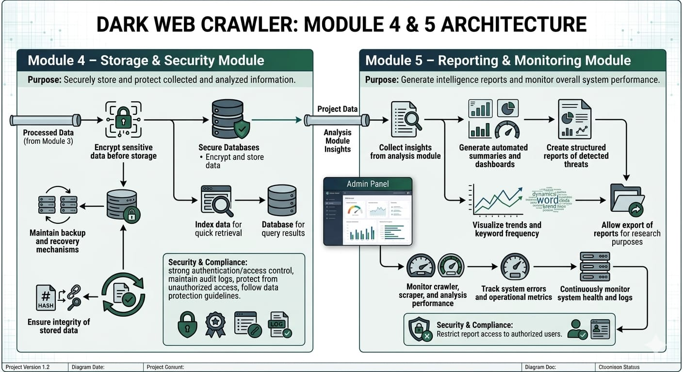

Slide 17
Conclusion
Dark web crawler and scraper system enables safe and efficient exploration of hidden web content.
Tor network integration ensures anonymity and security for researchers.
Modular design allows easy upgrades and maintenance.
Data analysis and filtering provide structured and meaningful insights.
Secure storage ensures data integrity and protection.
Ethical and legal controls minimize risks of misuse.
THANK YOU !

